Slide 1














About alphaaai
Fellowship
Dataset
Author
Regions
States
Cities
Shipping
US Superstore Data Analysis
Choose the menu to explore and understand the performance of a Superstore through the key performance indicators such as Sales, Profits, and many more…
Segments
Category
Subcategory
Discounts
Sales Person
Client Search
Returns
Insights
The Citizen Data Scientist Project
alphaa.ai

Slide 2

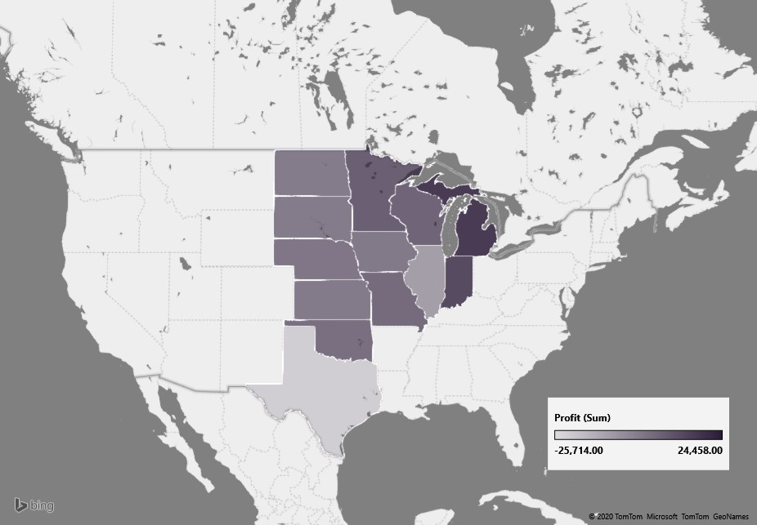




Regional Overview of the Superstore - Central
Regions
Central
West
East
South

Slide 3
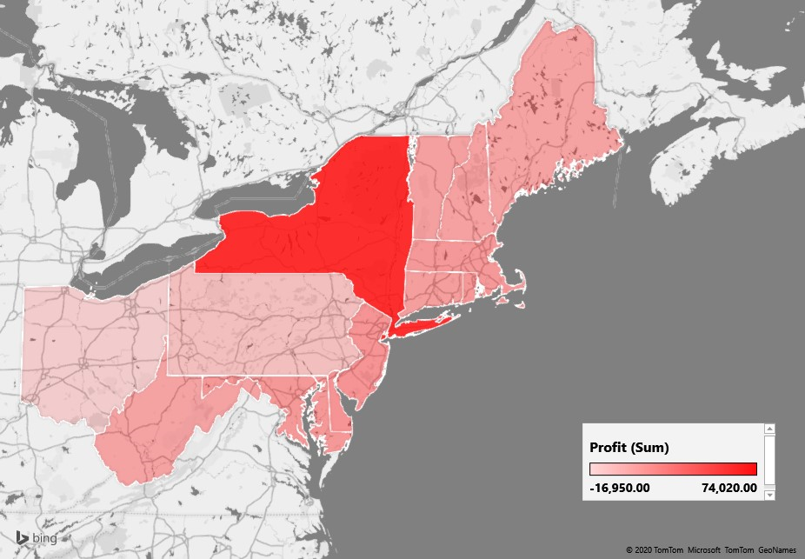
Regional Overview of the Superstore - East
Regions
Central
West
East
South

Slide 4
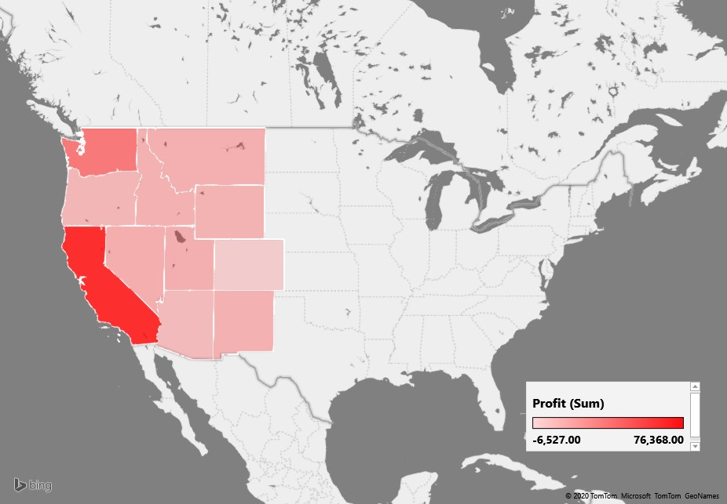
Regional Overview of the Superstore - West
Regions
Central
West
East
South

Slide 5
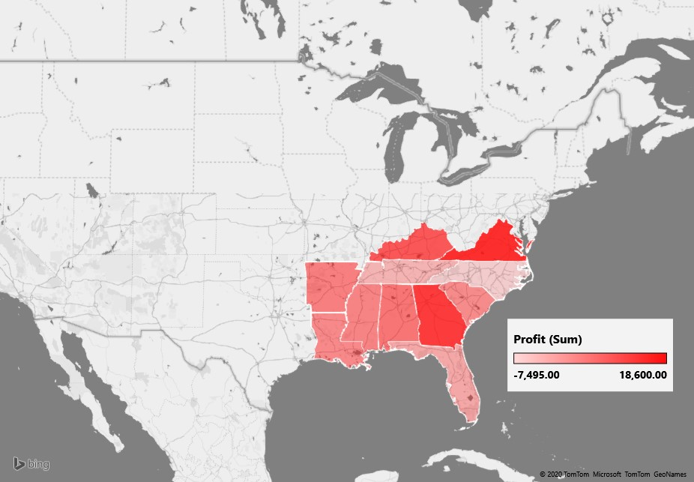
Regional Overview of the Superstore - South
Regions
Central
West
East
South

Slide 6

State wise Overview of the Superstore
States

Slide 7
City wise Overview of the Superstore

Slide 8
Shipping Overview of the Superstore
Ship Mode
Returns
States
Cities
Category

Slide 9
Shipping mode wise Overview of the Superstore

Slide 10
Effect of Shipping on Returns

Slide 11
Shipping overview of the superstore – State wise

Slide 12
Shipping overview of the superstore – City wise

Slide 13

Shipping overview of the superstore – Product Category wise

Slide 14
Segment wise overview of the superstore

Slide 15
Sub Category wise overview of the superstore

Slide 16
Category wise overview of the superstore

Slide 17
Discounts and Superstore Profits analysis

Slide 18
Sales Person’s Performance Analysis

Slide 19
Returned orders wise Superstore analysis

Slide 20
Product Insights

Slide 21
Client Search

Slide 22


Slide 24
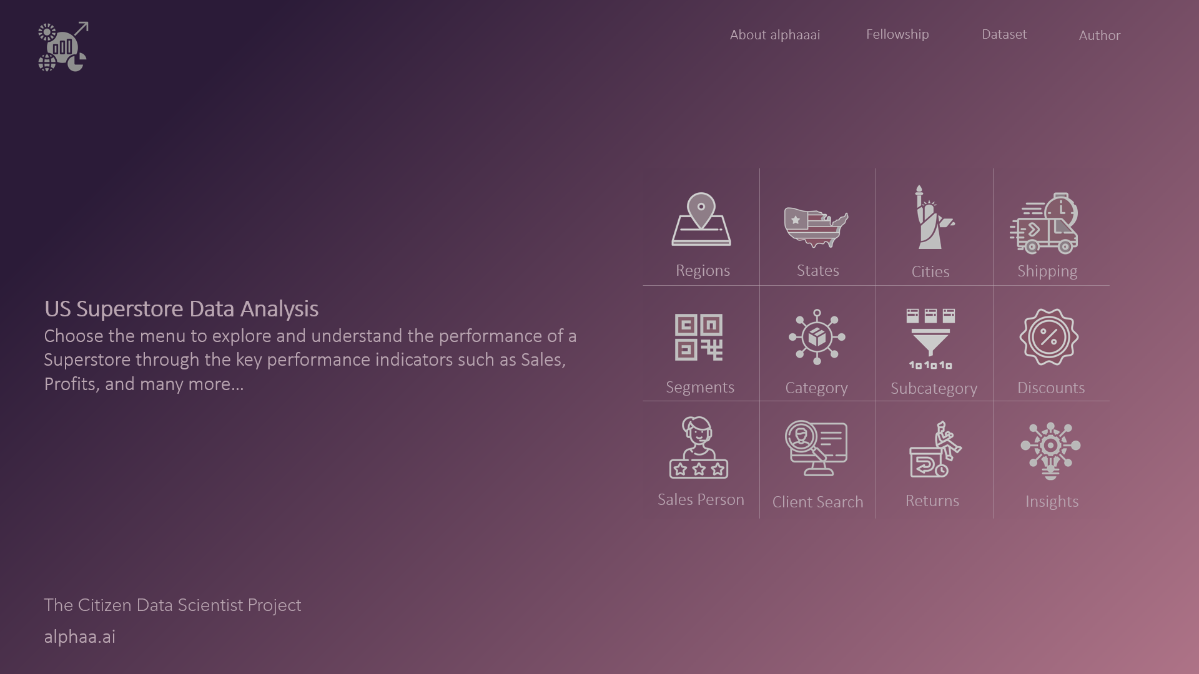

Slide 25
